Slide 1
( Hardware Block diagram: Tilt system)
XS1/XS2 (Plexon Start)
TILT DAQ
Tilt type ( 8-bit Strobe-> DSP)
Plexon (MAP)
Spikes, evnts
Tilt type
40KHz clk
Motor Start (24)
TTL conversion
cicrcuitry
(5<-> 24 V)
Motor Start (5)
SERVO DRIVE
Downsampler
clock
Spikes
PLEXON PC
Tilt type (5)
Motor commands
TILT PC
1250 KHz clk
TILT SYSTEM
LOADCELL,
INCLINOMETER
SENSOR DATA
LOADCELL DAQ
RAT
PREAMP
INC
Plexon (Breakout)
LFP
(LFP, INC, ds clk)
For BMI:
Plexon PC can send Neural data to TILT PC via TCP/IP (PlexNet)
Tilt PC : Programs to send tilt events, BMI decoding, record load cell data

Slide 2
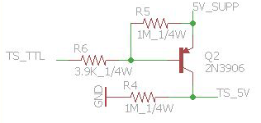
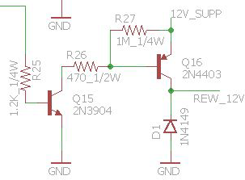
NI-DAQ TO MOTOR
24V TO 5V (MOTOR START SIGNAL) START SIGNAL FROM MOTOR
5 TO 12 V CONVERTER FOR WATER REWARD DELIVERY
NOTE: YOU ALSO 2 MORE 5 TO 24 V CONVERTER , IF YOU HAVE TO PROVIDE BMI INTERRUPTS TO MOTOR

Slide 3
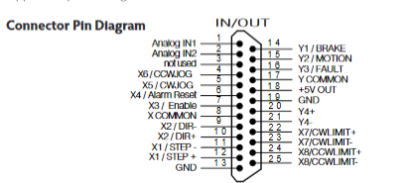
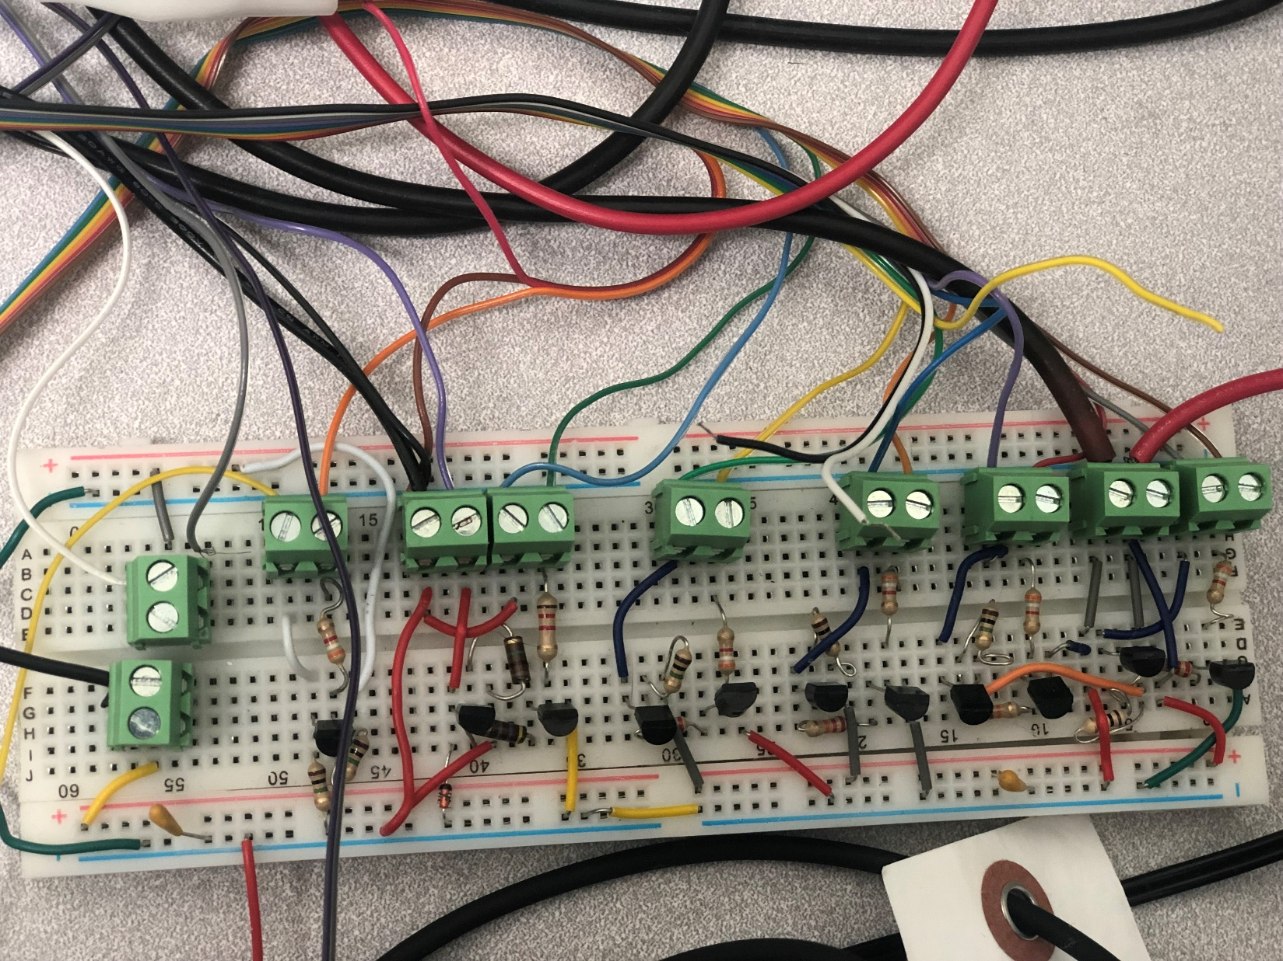
Xcommon/ycommon/x7/x8-/x2-/x1- <->ground
X8+/x2+/ → bmi interrupt (punishment/reward)
5 V SUPP
SMPS GROUND
GROUND
24V SMPS SUPP
5 V LINE
5 V INPUT FROM DAQ TO 24V OUTPUT (MOTOR)
12V OUT PINCHER ( WATER)
24 TO 5V
5-12V WATER
GROUND
TTL_0 (IN->P0.0 NI6289 5V)
TTL_0 (O/P- MOTOR X3)
TTL_1 (IN->P0.01 NI6289 )
TTL_1 (O/P- MOTOR X4)
Y2 (MOTOR IN)
TTL_2 (IN->P0.2 NI6289 5V)
TTL_2 (O/P- MOTOR X5)
MOTOR OUT (TTL MOTOR START)
TTL_3 (IN->P0.3 NI6289 5V)
TTL_3 (O/P- MOTOR X6)
24V LINE
12 V SUPP
WATER IN ( P0.4)
12 V LINE
GROUND
GROUND

Slide 4
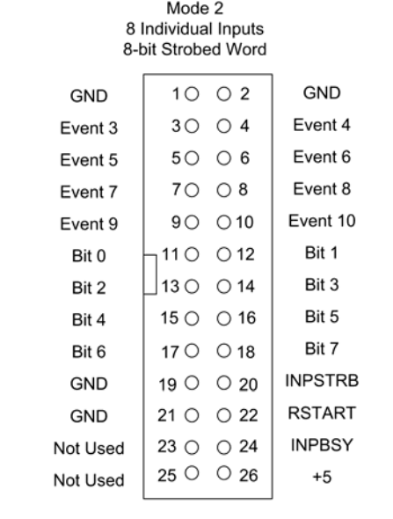
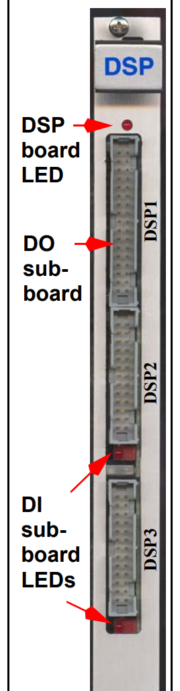
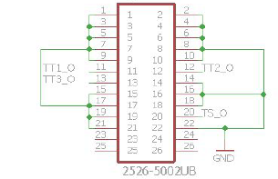
From TILT DAQ(USB 6289)
Motor start pulse
START PULSE FROM MAP ( XS1 TO NI DAQ 6289 P2.5)
INTERRUPT FOR BMI P1.2/P1.3 (USB 6289)
(MOTOR START)

